Slide 1
neoclassical.ai
Energy
Notes:
Hi. Welcome to this episode of Emergent Nature.
My name is J Mark Morris. I go by Mark.
In this episode I’ll discuss the error that caused science to go off track into general relativity and quantum mechanics.
That may seem like an unusual thing to say, since general relativity and quantum theory are generally considered to be successful effective theories.
However, as we will see, an error circa 1900 threw science off track.
There is a parsimonious solution to nature.

Slide 2




$$Standard matter particle assembly at rest in the aether$$
$Einstein : Energy= Mass$ * $c^{2}$
$$Nature :{ Energy}_{APPARENT} = Mass\text{ ∗ }c^{2}$$
${Energy}_{TOTAL}$ = ${Energy}_{APPARENT}$ + ${Energy}_{SHIELDEDviaSUPERPOSITION}$
$Point potential isolated in a Euclidean void of space and time (velocity not defined)$
$Let the symbol @ correspond to the universal constant speed of potential emissions$.
${Energy}_{TOTAL} ={Energy}_{APPARENT}$ = ${q ∗ @}^{2}$
$$Duality$$
$$Point potential fields travel radially from emission at speed @.$$
$$Photon structures travel at c, the local speed of light through the aether.$$
$$Local c approaches @ as{ Energy}_{APPARENT} of the aether approaches zero.$$
J Mark Morris

Slide 3
neoclassical.ai
Hamiltonian
Notes:
Hi. Welcome to this episode of Emergent Nature.
My name is J Mark Morris. I go by Mark.
In this episode I’ll discuss the error that caused science to go off track into general relativity and quantum mechanics.
That may seem like an unusual thing to say, since general relativity and quantum theory are generally considered to be successful effective theories.
However, as we will see, an error circa 1900 threw science off track.
There is a parsimonious solution to nature.

Slide 4
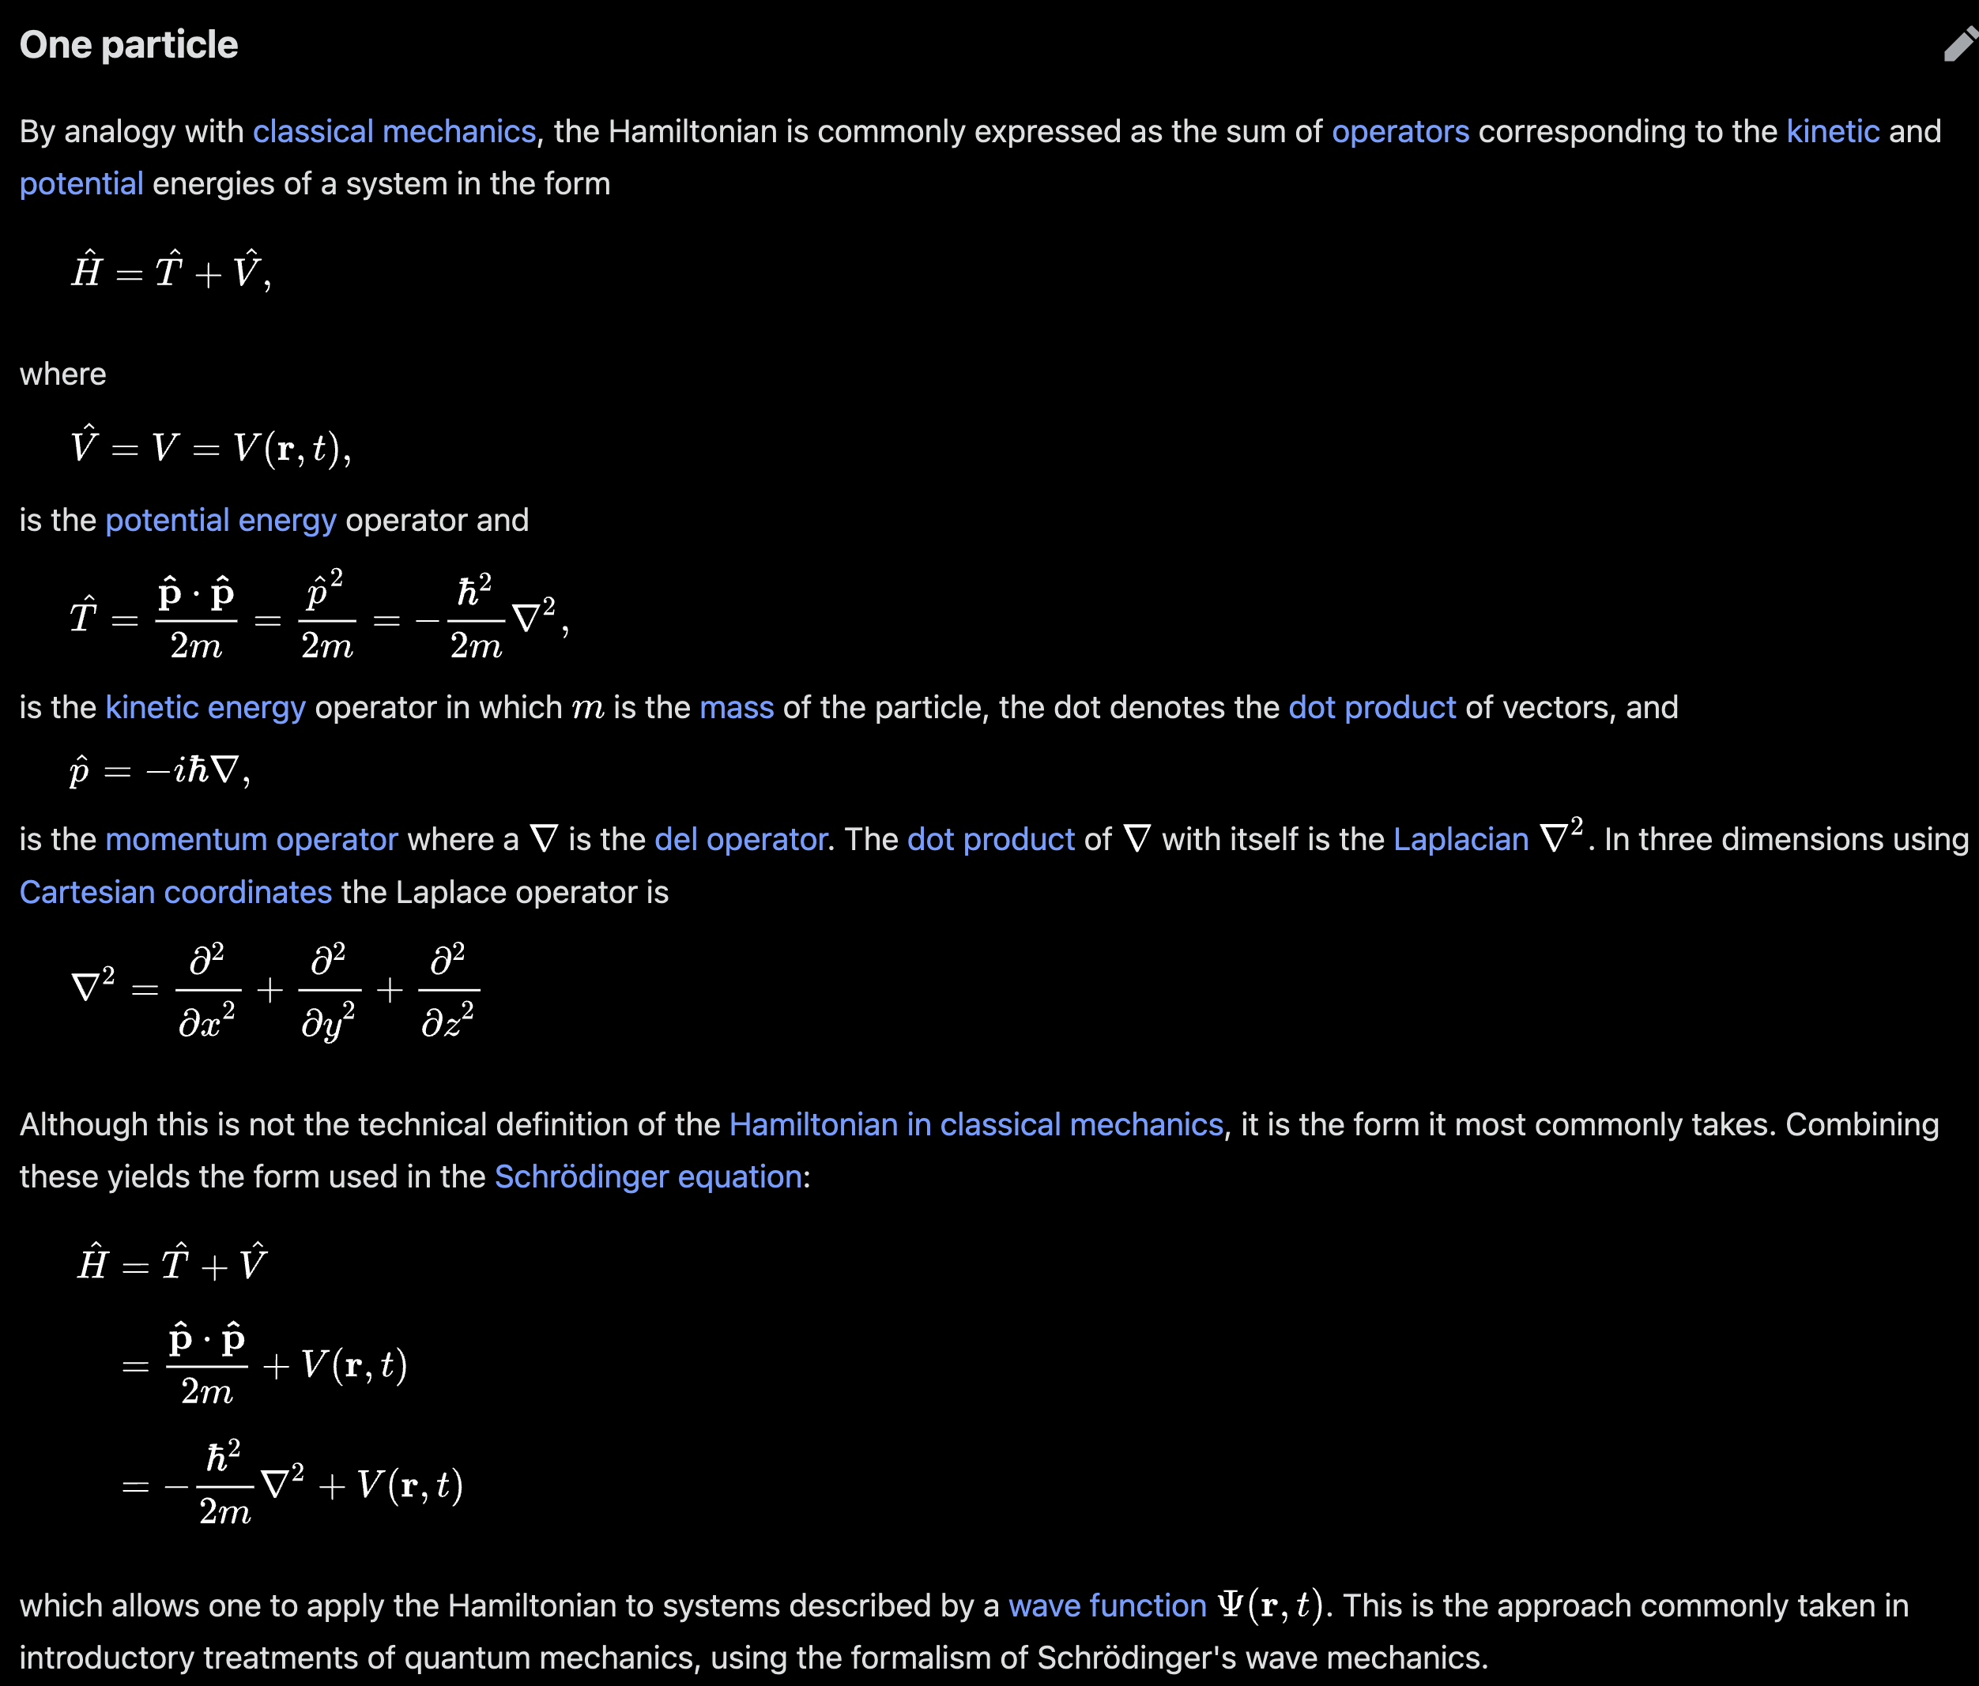
Hamiltonian
In quantum mechanics, the Hamiltonian of a system is an operator corresponding to the total energy of that system, including both kinetic energy and potential energy.
mm: so we have momentum type energy = KE = qv?
Its spectrum, the system's energy spectrum or its set of energy eigenvalues, is the set of possible outcomes obtainable from a measurement of the system's total energy.
mm: We don’t have possible outcomes in neoclassical theory
J Mark Morris

Slide 5
Thank You
Questions?

Slide 6
Foundation for a dynamical geometry of nature and the universe
Imagine two point potentials isolated in T3S.
Draw a picture with opposite point potentials starting out at a very large real distance.
Show it on the 1/r curve.
KE on the ends is 0, and let’s say each potential has a PE equal which we will show is q@²/2 at v = 0
Now start the experiment and they attract and their velocity approaches @ asymptotically
The potentials blow right through each other, which is fine.
We can’t start the experiment at true infinity, but if we could, then the potentials would pass at v = @.
So at the moment they pass, the PE is zero since the potential field is defined as 0 at r=0.
Therefore KE must be q@²/2 + q@²/2 .
So we have the equation PE + KE = q@² since energy is conserved.
In this specific system due to symmetry, PE + KE = q@²/2 for each point potential
But this is different from the virial theorem. Why is that?
I am probably confused. I don’t think I have the potential to mass mapping thought out.
“The relationship between kinetic energy and momentum is given by the equation T=p²/2m, where T is kinetic energy, p is momentum and m is mass. This relationship comes directly from the definitions of momentum (p=mv) and kinetic energy (T=½mv²).”
J Mark Morris

Slide 7
Accounting for Energy
the symmetry breaking point flip is particularly important because it is asymmetrical.
As we know it is the transition from inflation and expansion.
We know the rate of change of slope starts high and decreases to 1 at the symmetry breaking point
At v<@ when expanding, the rate of change of slope starts at 1 and increases over time
This is a lot like a transistor. Two ranges of behaviour. The physics are different.
what if energy accounting is on a delay basis. is there a time delay Hamiltonian?
There is a delay between emission and action and the delay to return the feedback.
In the end, everything works out, but the books can be slightly out of sync.
Energy exchange is not an atomic transaction.
It is a committed yet lazy self correcting update.
Does this make sense if all Noether cores balance the mid binary at v = @?
Then the mid binary is resting on the symmetry breaking point and sometimes goes one way or the other based on causally out of sync emitters.
Is there math or information theory on this topic.
But any h-bar step in energy can rest on the edge of up or down. local perturbations flip an energy level.
So why is the symmetry breaking point so important?
Is v > @ an energy generation state?? Self action went from zero to high quickly.
J Mark Morris

Slide 8
Conjecture
all binaries in a Noether core of spacetime tend to couple and try to equalize in energy
but when the variation is too high, it is like a transmission not engaging
but I presume binary couplings also change and jump around, for reasons
perhaps the high energy binary couplings in the Noether cores are more synchronized and in a locked state?
Mid energy is probably at v = @ might lock states with other mid energy binaries
it is probably the outer binaries that really jump around in coupling.
So perhaps that has a lot to do with apparent energy (mass) when spacetime Noether cores couple with fermions
Mass would represent the amount of coupling to fermions in local spacetime assemblies.
The more concentrated the mass, the more engagement of local spacetime assemblies.
J Mark Morris

Slide 9
Is PE + KE a constant? It is quite complex.
Consider these cases
A point potential kicks over v = @ and gets a boost from work done upon it by its own self action
the energy to kick it over the symmetry breaking point is less than the energy gained.
The point potential binary continuously generates a sphere stream that spirals through the universe creating a differential potential which is available for work.
Consider a binary and two arbitrary local opposite point potentials as a system. (two electrinos and two positrinos)
each point potential has an 8-ball.
it might be two binaries at times, but everything evolves, the binaries may even switch partners
What is the intuition here?
it seems like a binary is a perpetual rotor and the wake that it creates can do work.
yet is there some overall equal and opposite effect??
this will take more time to visualize and conceptualize
Just break it down to similar and opposites duos.
KE changes relate to the point potential changes on a 1/r potential curve.
Orbiting on a 1/r geodesic does not change KE magnitude.
If KE is a vector then there is more math.
J Mark Morris

Slide 10
Binary Energy Equalization to Equilibrium
Quantum behaviour emerges from a continuous geometry.
The neighborhood of spacetime Noether cores are attempting to equalize apparent energy.
They are all trading in quanta of energy in pi/2 state increments
They operate like a slipping transmission, forward or backward.
In a local neighborhood, assemblies quickly reach equilibrium.
At the fundamental level, below these assemblies, it is a continuous system.
Where do the mathematical implications of skipping a beat apply?
The skipping a beat is the well exercised conditions at the end of each state.
Arriving potential spheres influence the quantum choices.
In a lightly perturbed locality, the assemblies quickly arrive at equilibrium.
IDEA: the denser the point potentials, the more energy they capture.
An isolated point potential, distant from others, has little influence
A point potential in the local neighborhood causes significant action
J Mark Morris

Slide 11
Template
x
J Mark Morris

Slide 12
Known physics may correctly assess that the binary would spiral to what they thought was oblivion for various reasons.
But they didn’t understand that was merely the symmetry breaking point between the CFT and AdS regions
We can leverage this into a more abstract and yet correct energy analysis.
i.e., add an h, frequency increases from 0 to 1, what did we learn?
these are points on the natural spiral so we know they are valid.
we must be cautious to remember that stability is the natural spiral behaviour
I think what is possibly confusing is that there are natural rates of change, in fact two of them
so when we apply more energy that is changing the rate at which things were changing, thus an acceleration or deceleration.
once the energy transfer stops, then those changes are locked in and we continue the natural progression from there.
Vector potential q/(vr) intersecting a point potential with an eightball. What happens.
Analysis of Energy in an Ideal Binary
The natural unperturbed ideal spiral is the self powered spiral with two regions.
CFT Region : rate per spiral cycle = h (partner action)
AdS Region : rate per spiral cycle = h (partner action) + g (self action)
radius, frequency, velocity all have first and second degree derivatives
this defines a natural emergent timeline – our rate of time vs the natural rate.
For ideal constant rate gains of energy in the form of angular momentum,
radius will get smaller more quickly,
frequency and orbital velocity will get faster more quickly
For ideal constant rate losses of energy in the form of angular momentum,
radius will get larger more quickly,
frequency and orbital velocity will get slower more quickly
J Mark Morris

Slide 13
Thank You
Questions?

